Slide 1

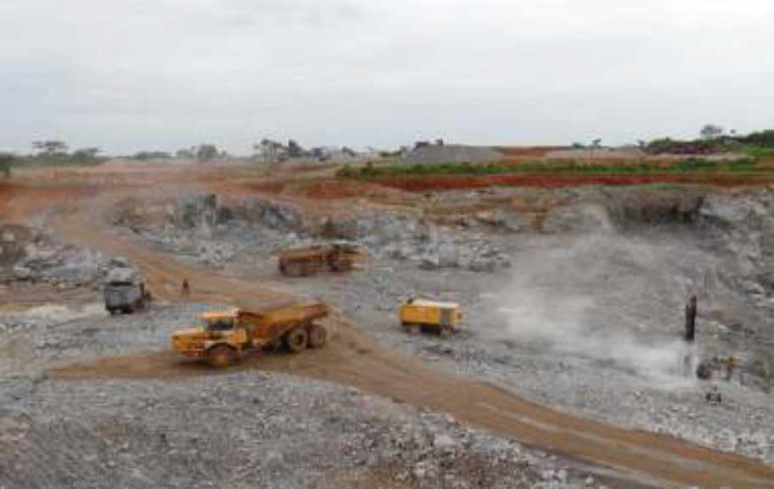
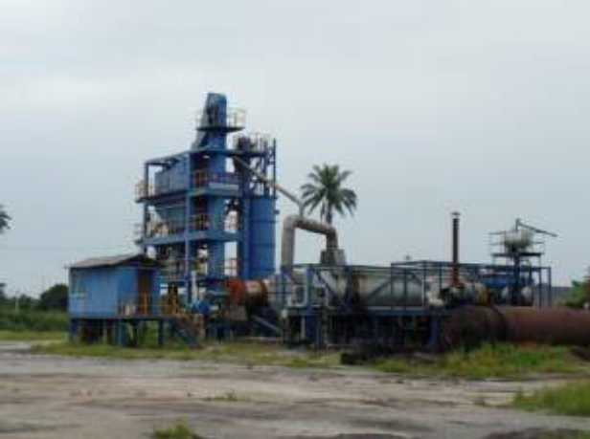
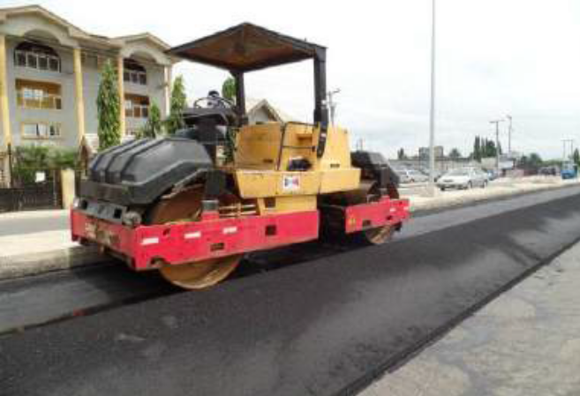
SANDROVE GLOBAL RESOURCES LIMITED
COMPANY PROFILE
HEAD OFFICE: No 206A Aba Express Road, Port Harcourt, Rivers State, Nigeria.
Tel: +234 8028805693, +234 8075471294
Email: sandroveglobalresources@gmail.com, ovie@sandroveglobalresources.com
1

Slide 2
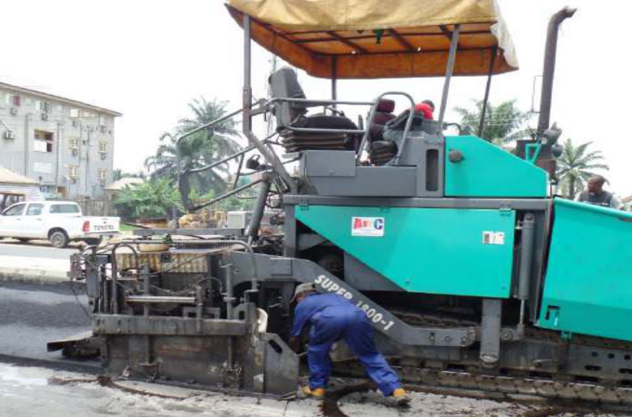
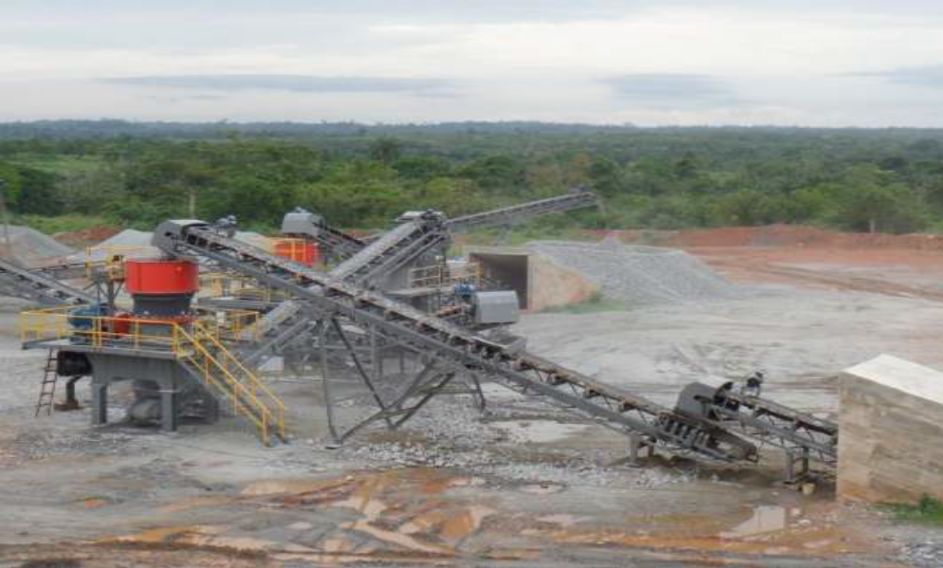
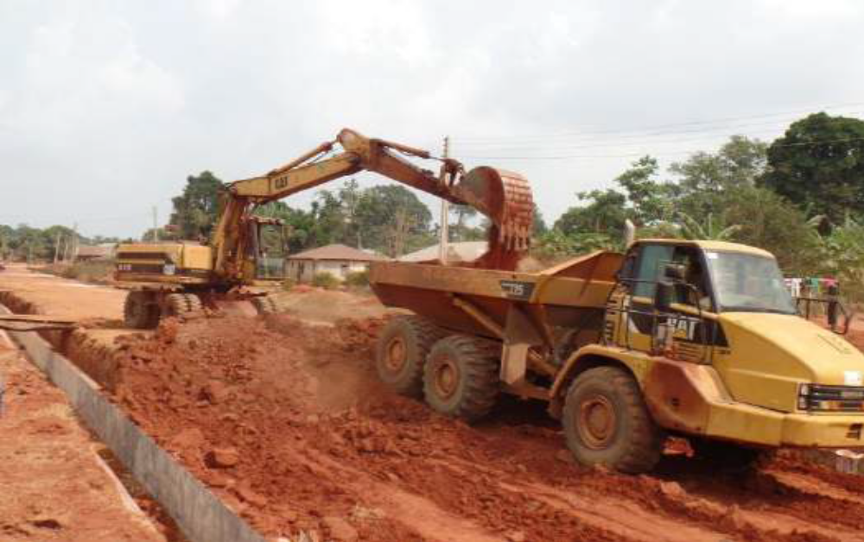
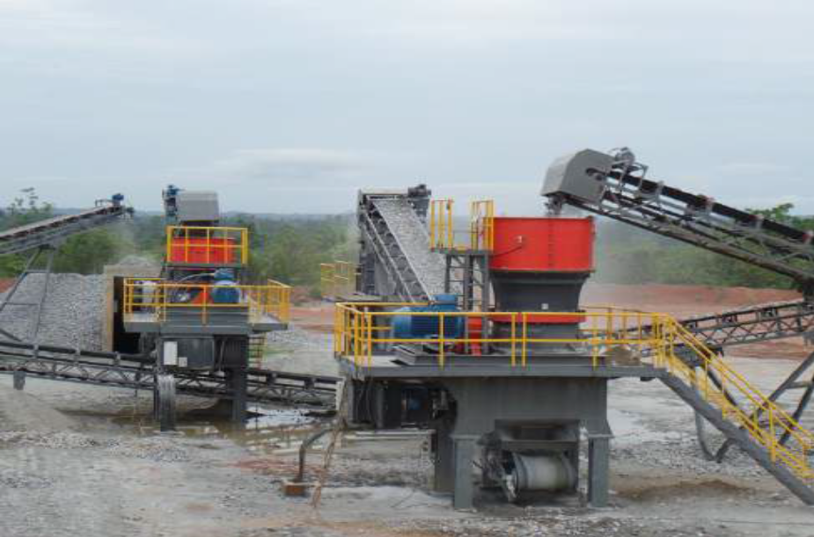
2

Slide 3
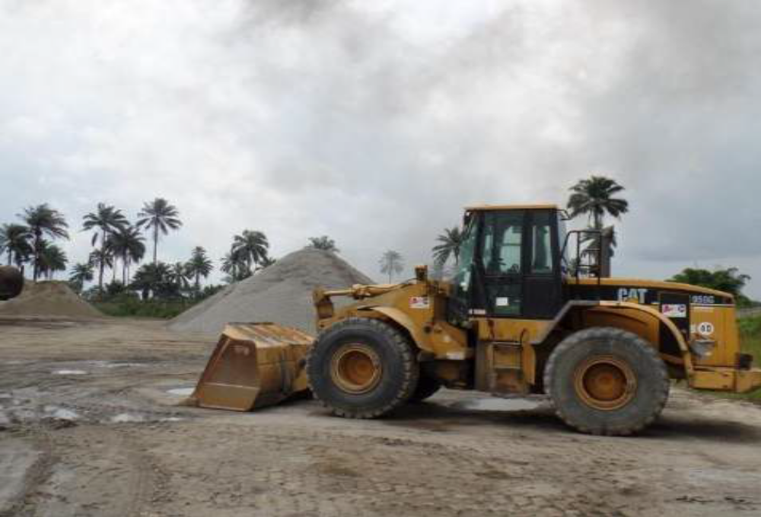
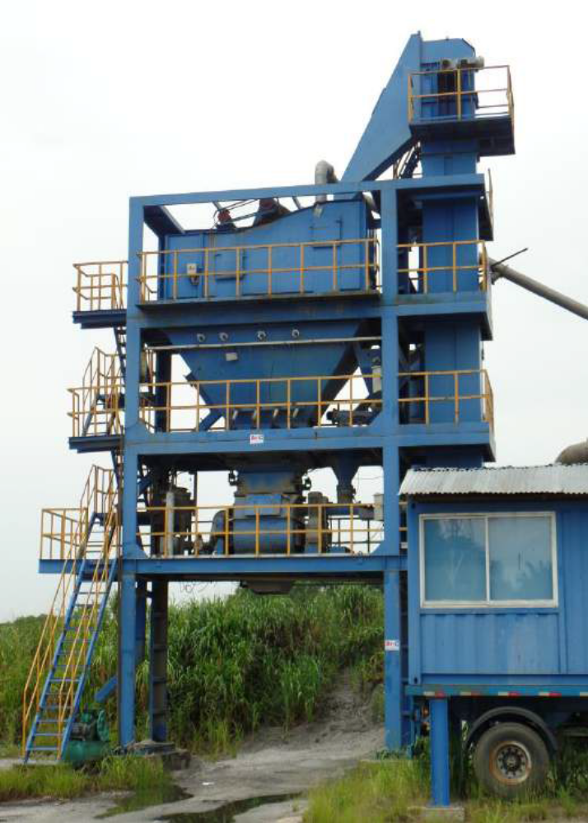
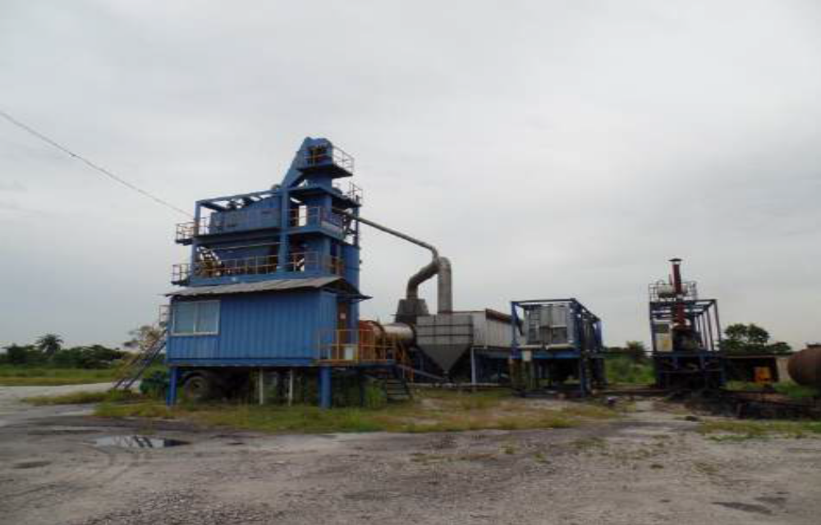
3

Slide 4
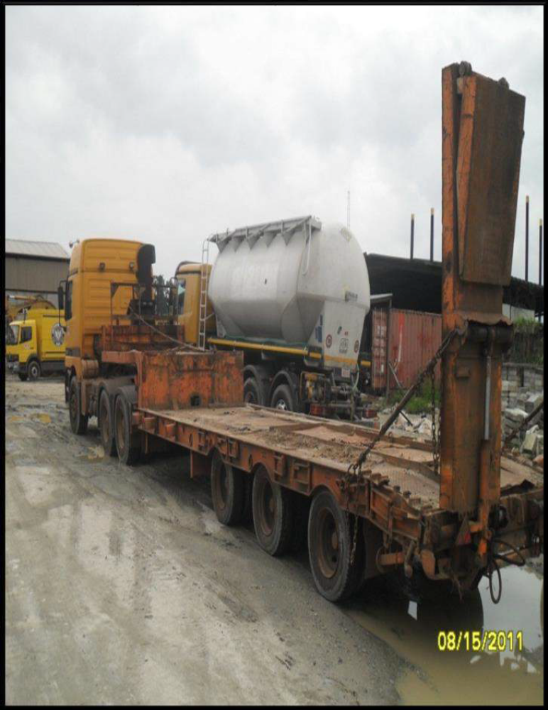
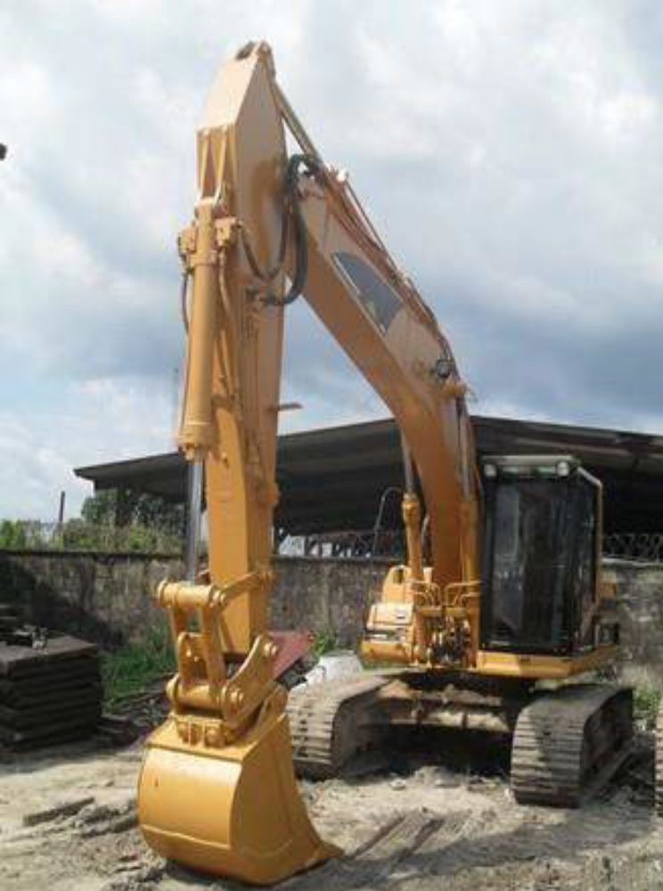
4

Slide 5
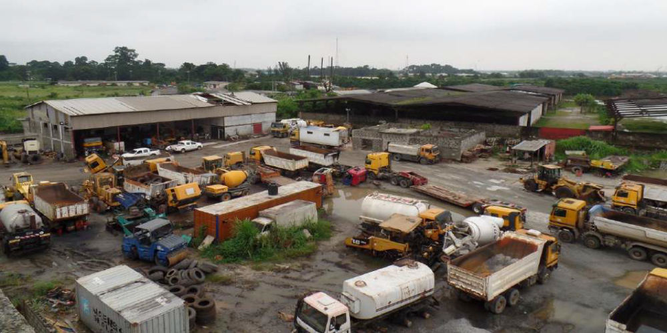
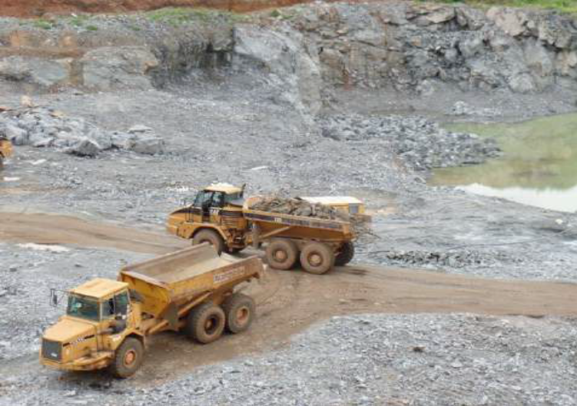
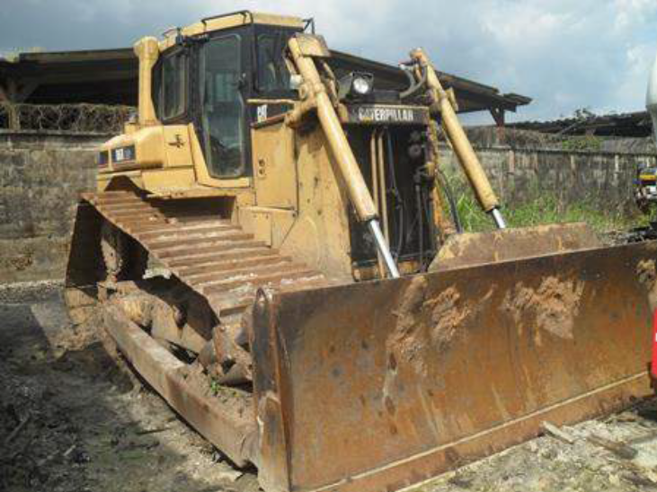
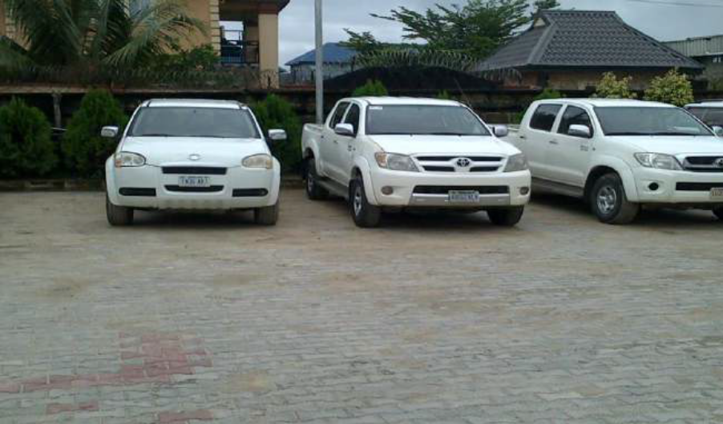
5

Slide 6
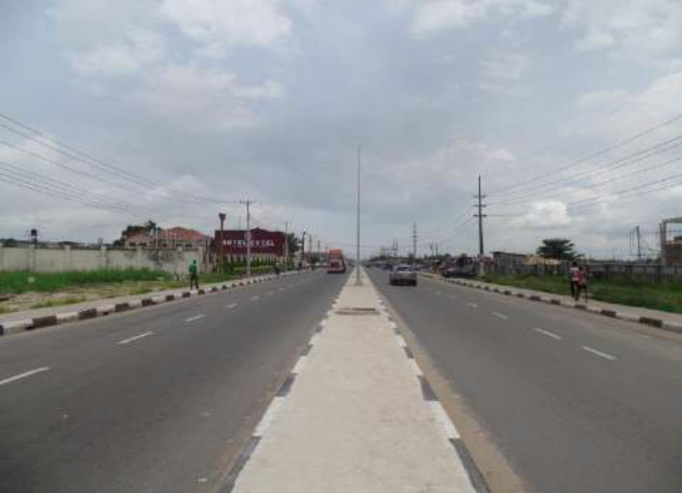
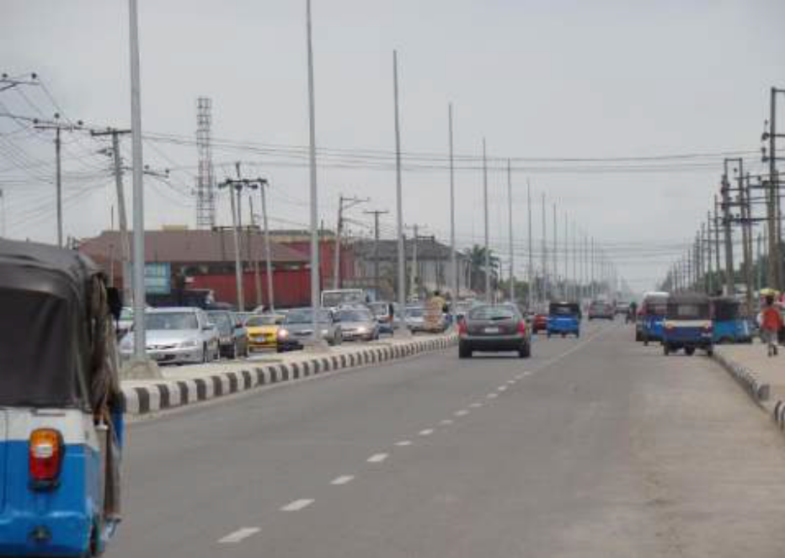
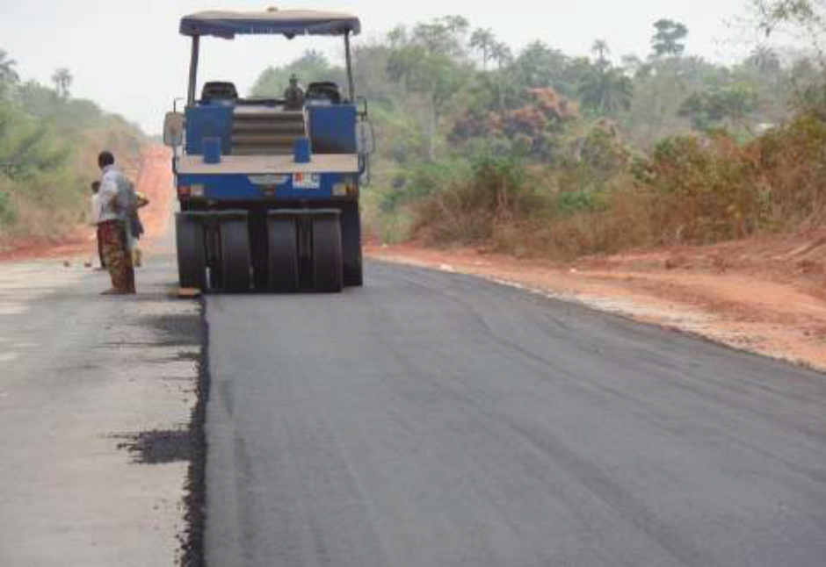
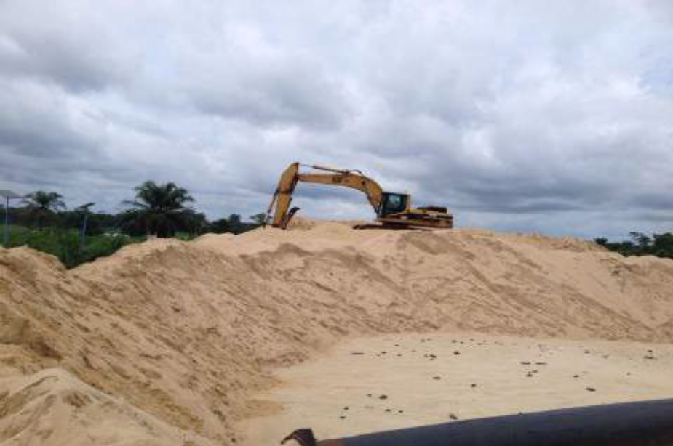
6

Slide 7
PROJECT EXECUTED AND ON - GOING
ORGANIZATION
Due to ever increasing complexity and magnitude of current projects, clients’
demands and requirements for a near perfect and timely completion is taken
care of by a well-organized sequence with includes but not limited to the
following aspects:
• Operations (Africa, Africa Sub-Region)
• Procurement
• Quality
• Human Resources
• Information Technology
• Finance
• Estimation
• Legal
Since we are committed in giving our best in the execution of our job, our clients
are spread around.
Some of our Major Clients includes:
• Federal Ministry of Works
• Federal Road Maintenance Agency (FERMA)
• Niger Delta Development Commission (NDDC)
• Delta State Government
• Edo State Government
• DESOPADEC
• Shell Petroleum Development Commission
Listed below are some of our projects carried out.
7

Slide 8
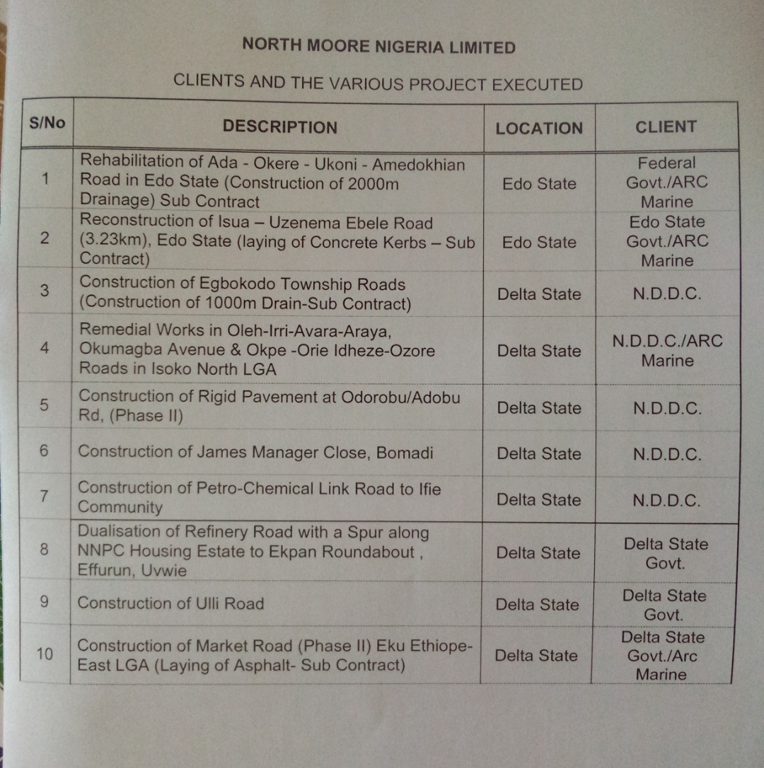
SANDROVE GLOBAL RESOURCES LIMITED
CLIENTS AND THE VARIOUS PROJECT EXECUTED
8

Slide 9
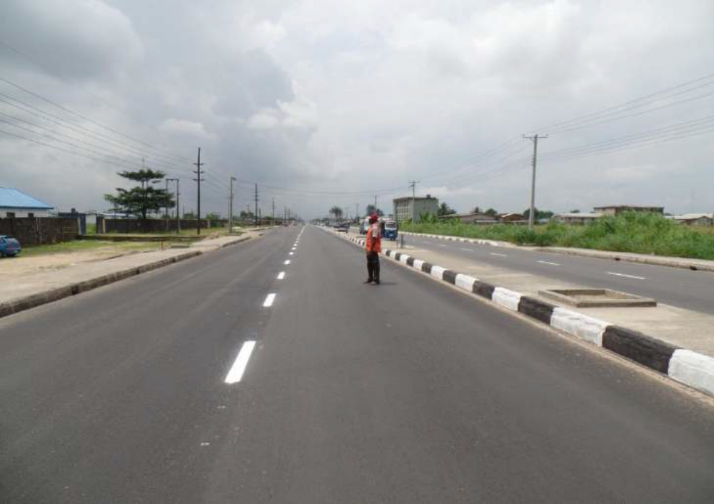
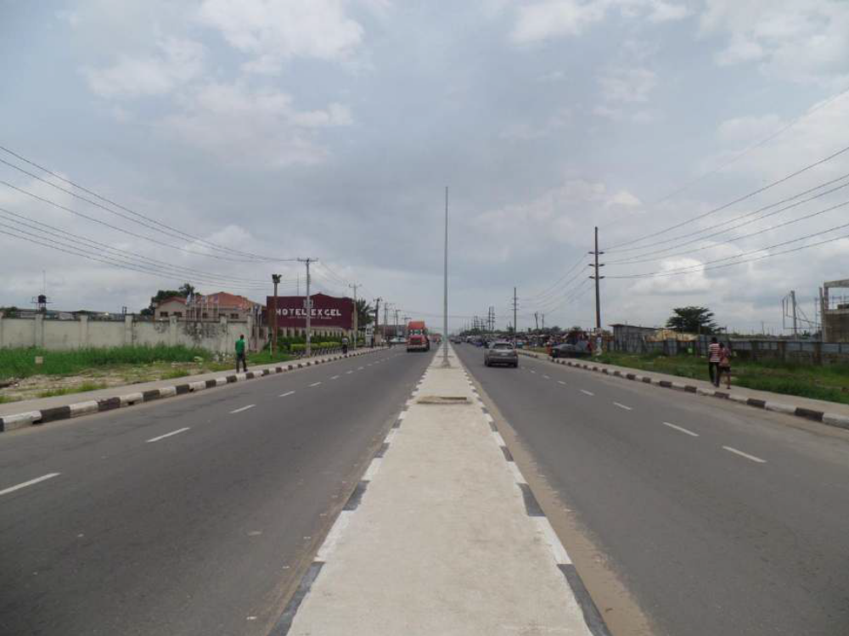
ROAD MARKING AND CONSTRUCTION OF CONCRETE MEDIAN
DUALISATION OF REFINERY ROAD, EFFURUN
RECONSTRUCTION OF AMENDOKHIAN-UGBOHA ROAD
9

Slide 10
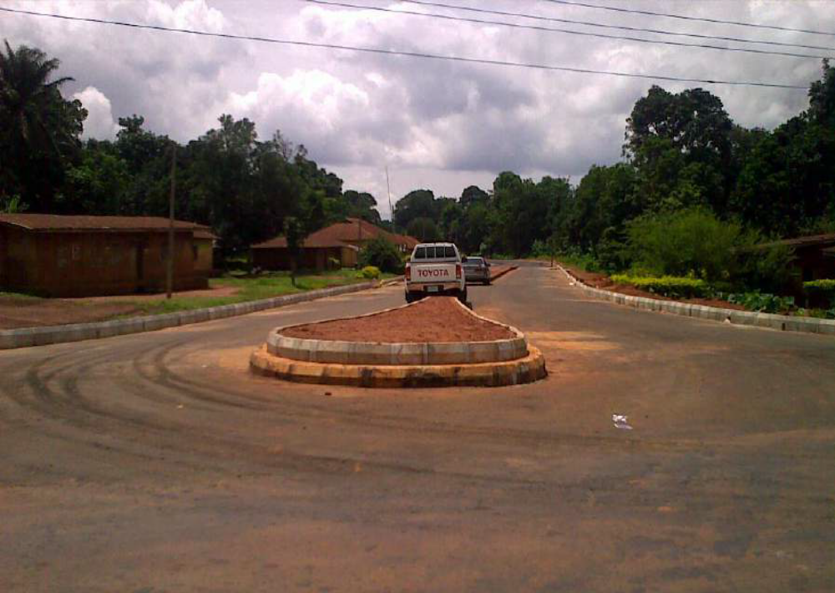
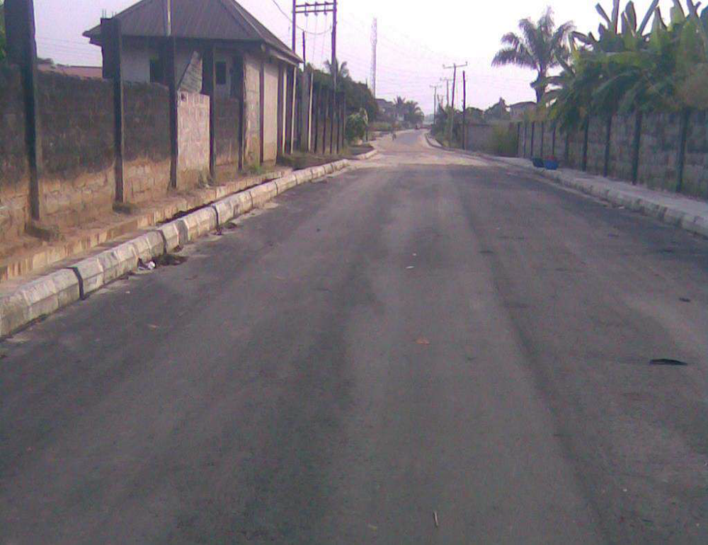
RECONSTRUCTION OF AMENDOKHIAN-UGBOHA ROAD – LAYING OF KERBS
CONSTRUCTION OF EGBOKODO TOWNSHIP ROADS – LAYING OF CONCRETE
10

Slide 11
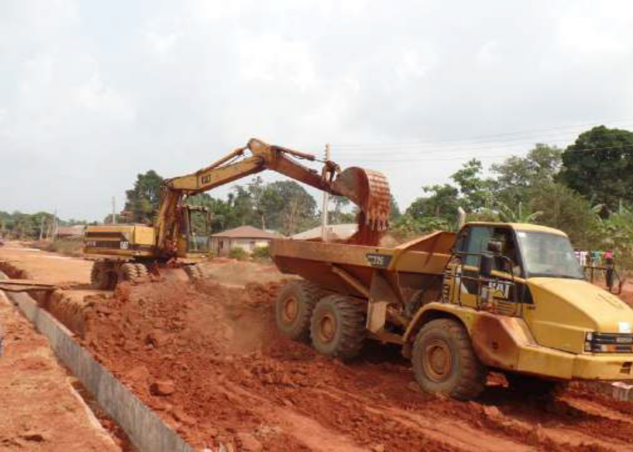
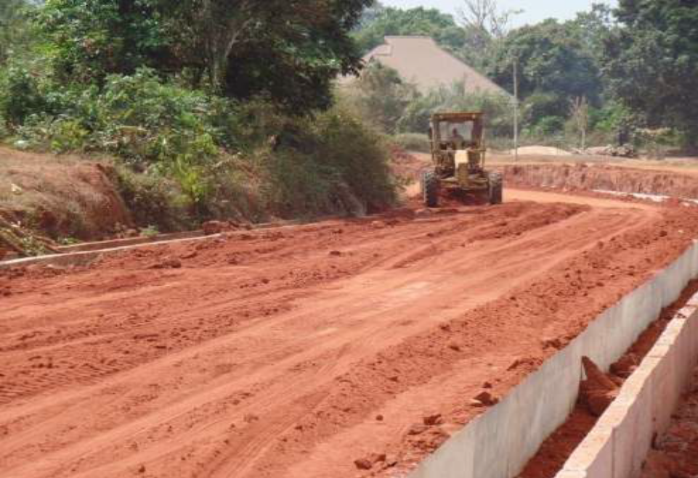
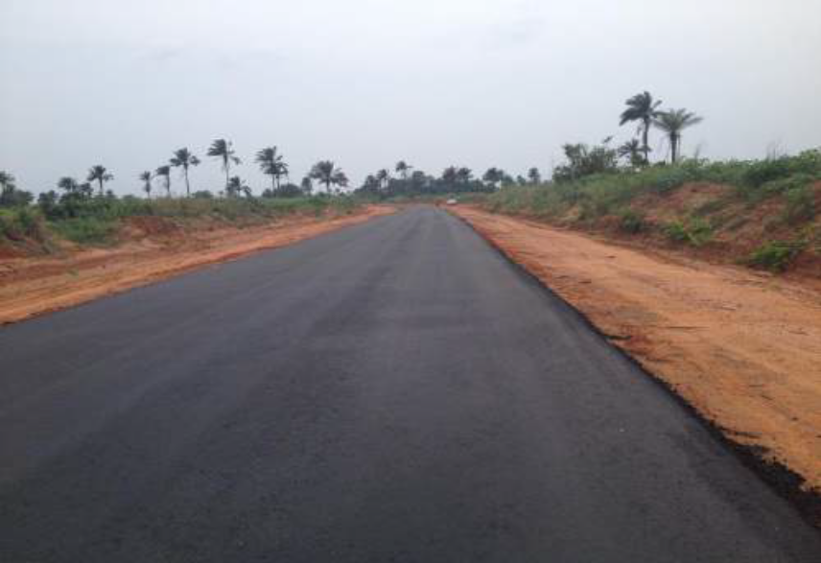
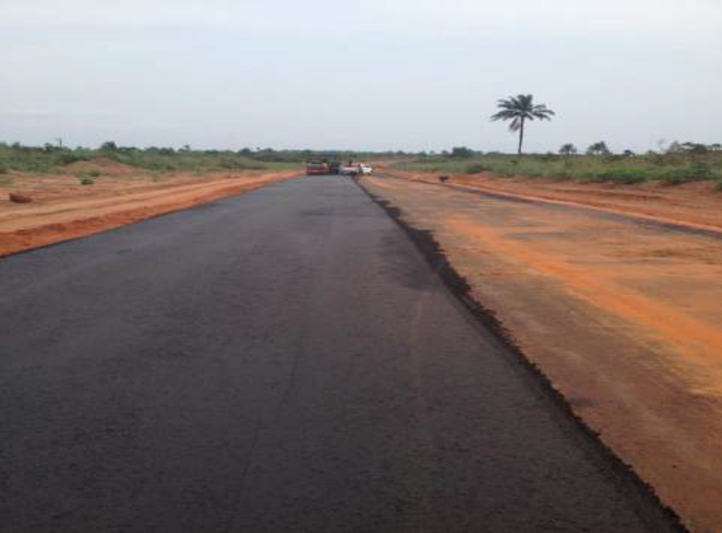
11
REHABILITATION OF ADA – OKERE – UKONI ROAD IN UROMI –
CONSTRUCTION OF CONCRETE DRAINS

Slide 12
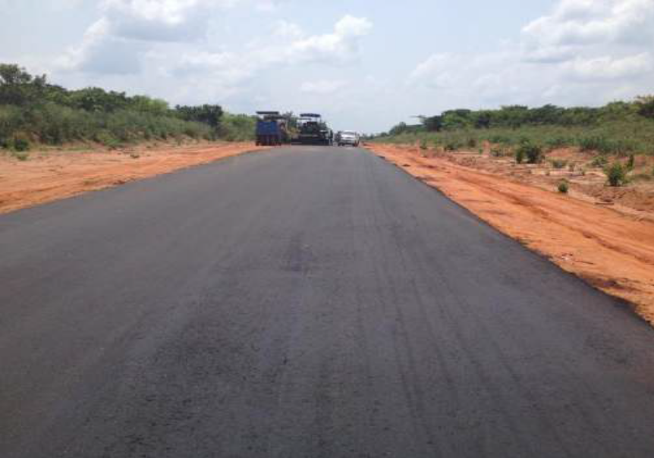
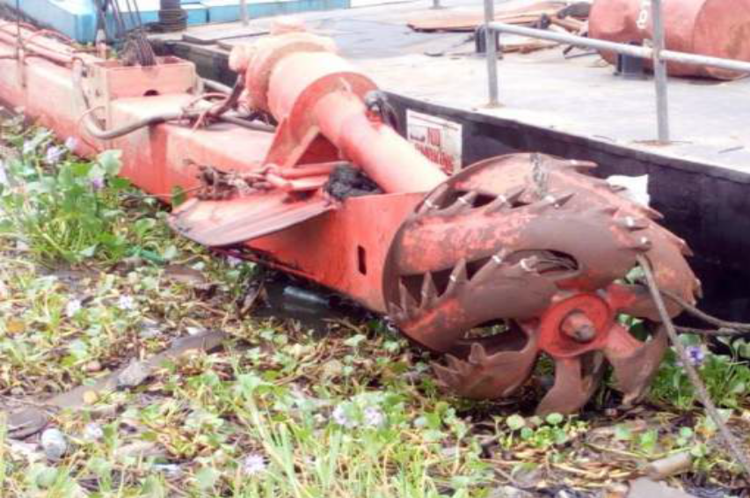
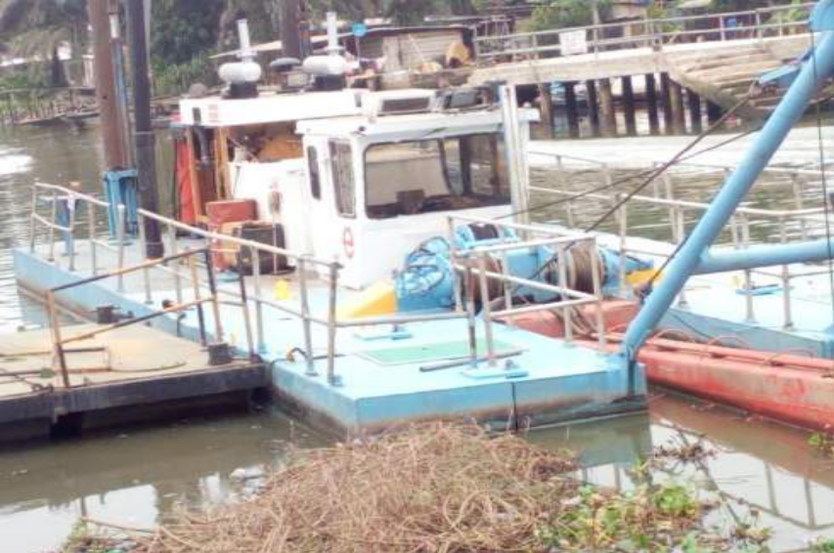
DREDGERS ON WORK
12

Slide 13
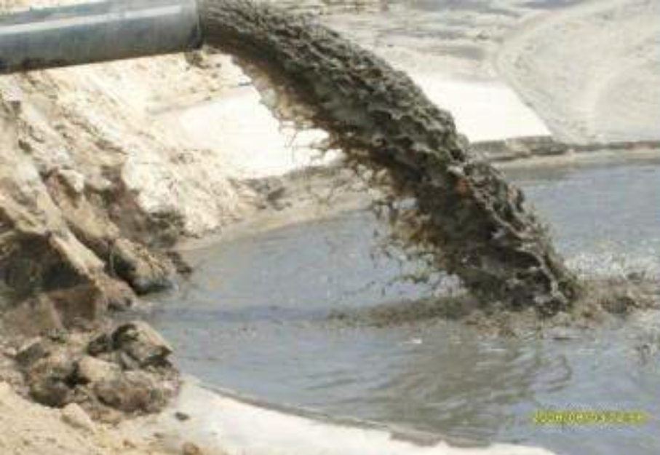
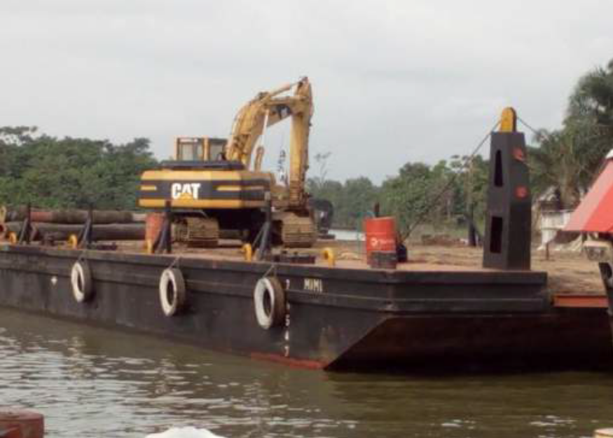
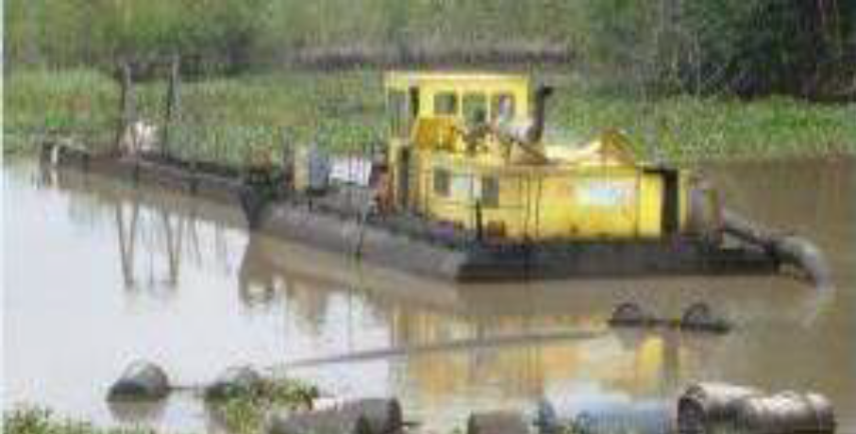
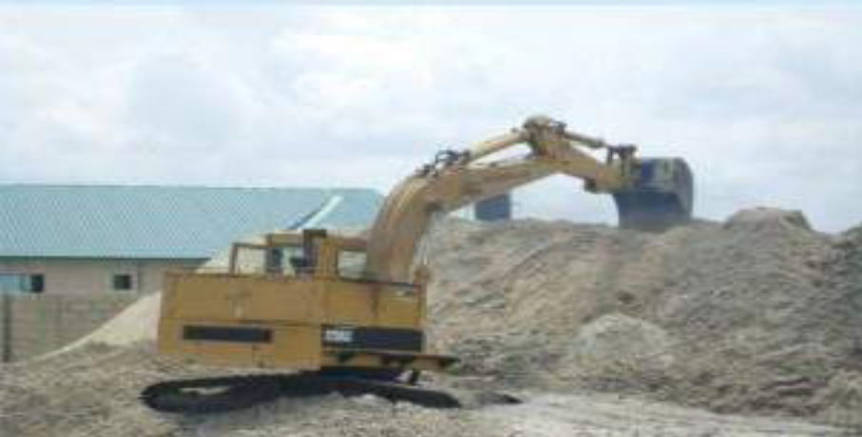
13

Slide 14
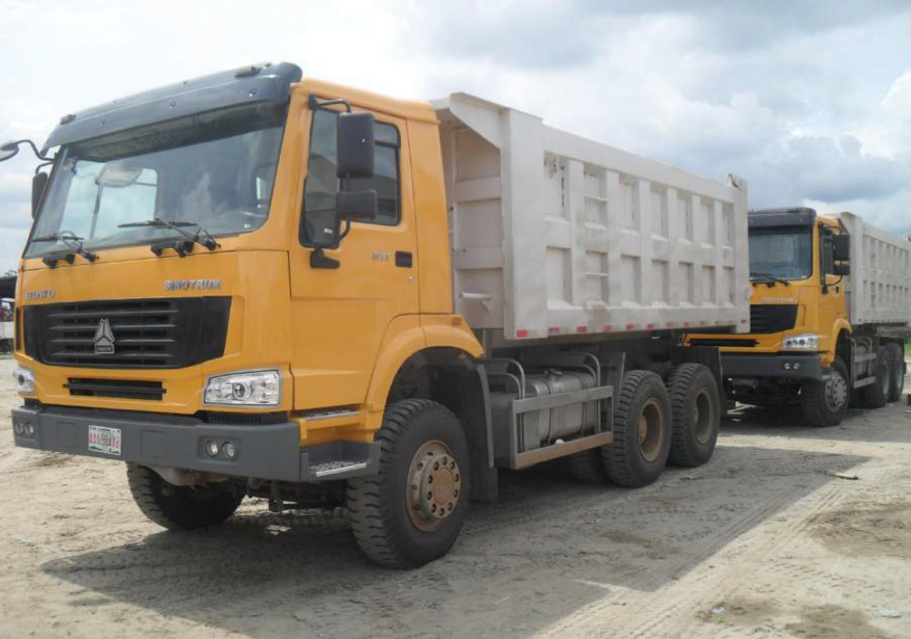
SPICEMEN PICTURE OF TRUCKS.
14

Slide 15
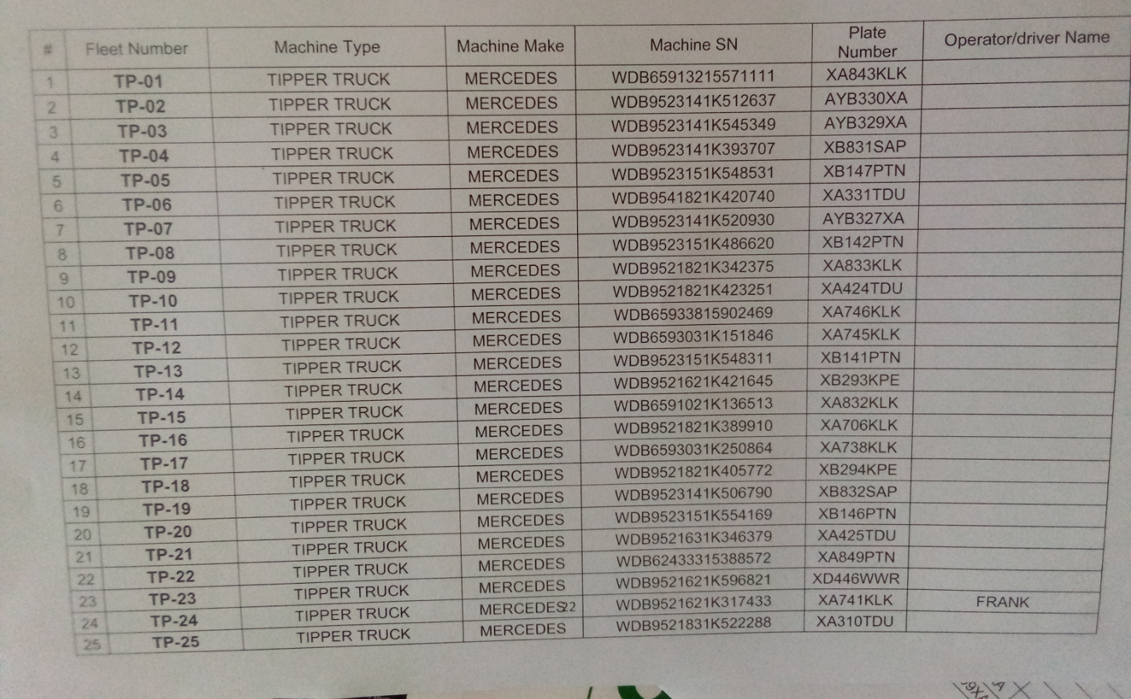
15

Slide 16
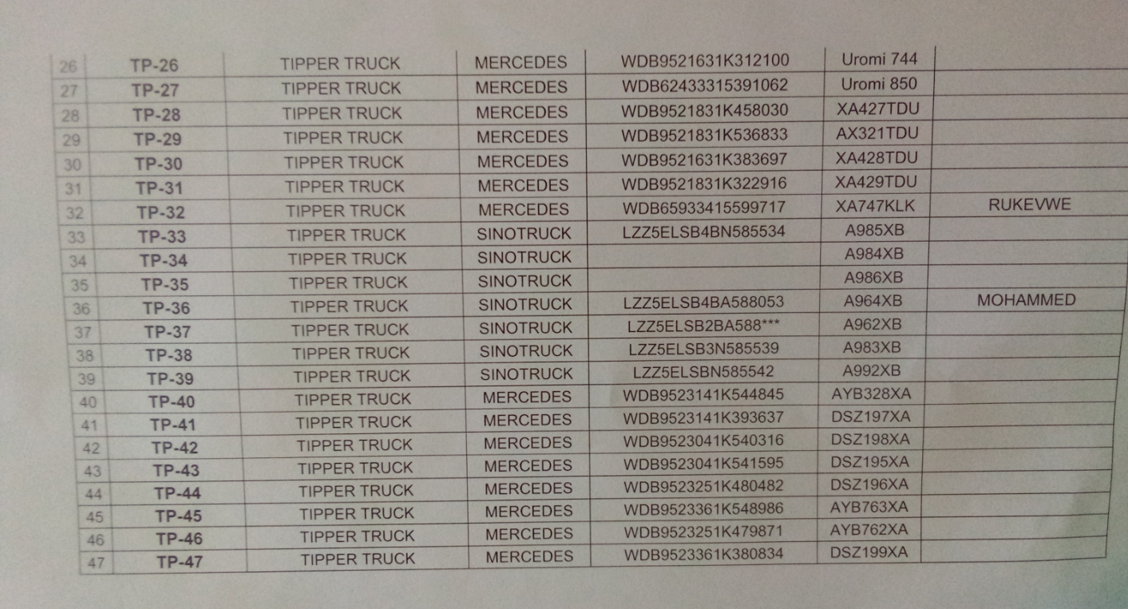
16

Slide 17
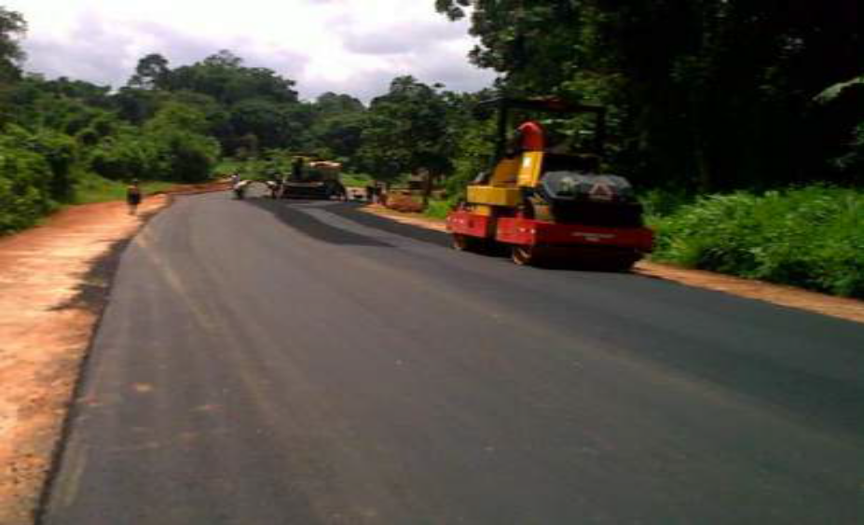
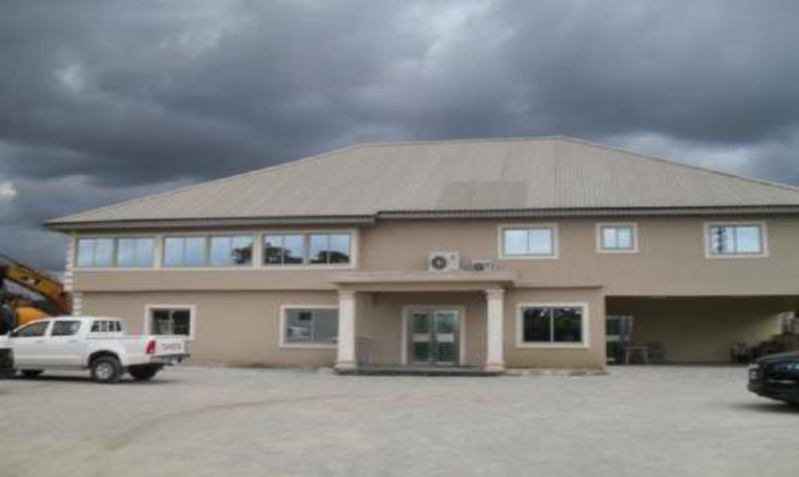
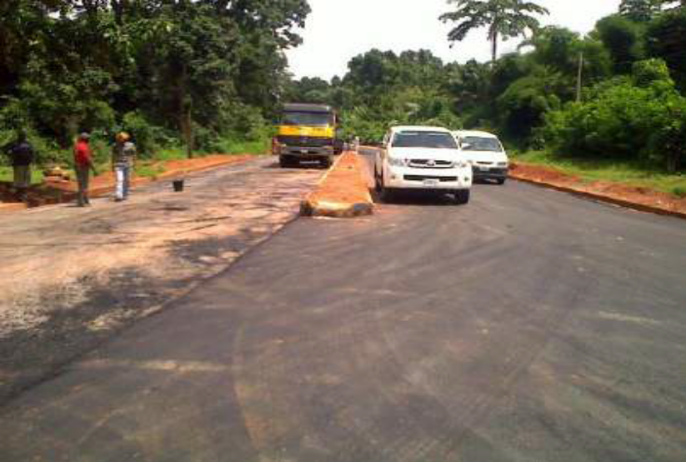
17

